Slide 1
SPRFMO experiences with management areas and stock definitions and some chub mackerel assessments in the East Sea
Alaska Fisheries
Science Center
Jim Ianelli
Resource Ecology and Fisheries Management
Alaska Fisheries Science Center
NMFS NOAA
May 16 2017

Slide 2
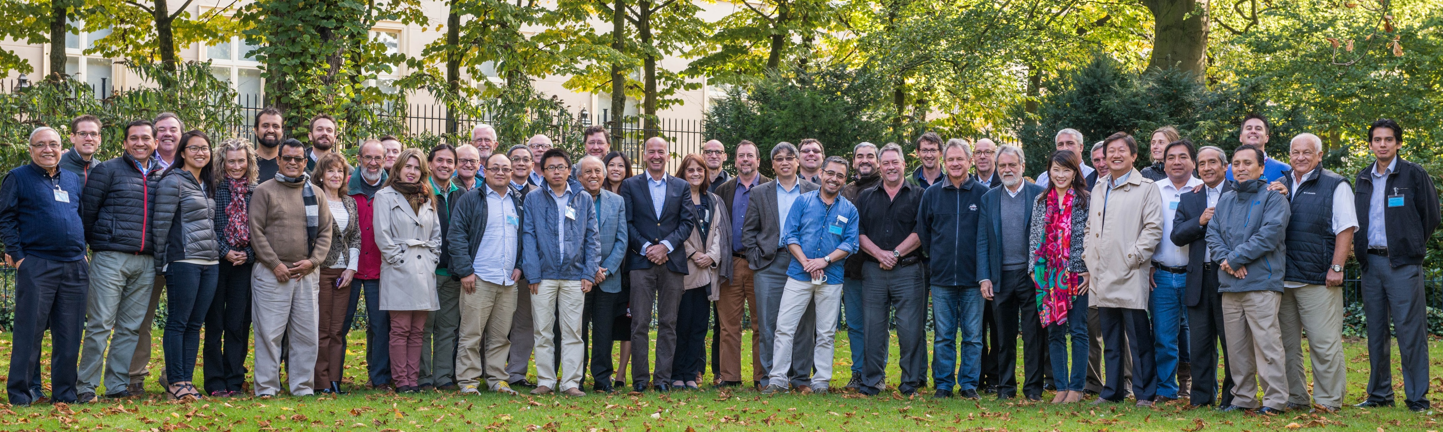

4th Scientific Committee October 2016
Acknowledgements:
Scientific Committee, 52-participants from 13 countries
https://www.sprfmo.int/meetings/4th-sc-2016/
Notes:
What do I want them to get out of this talk? An appreciation of pulling together data and providing advice

Slide 3
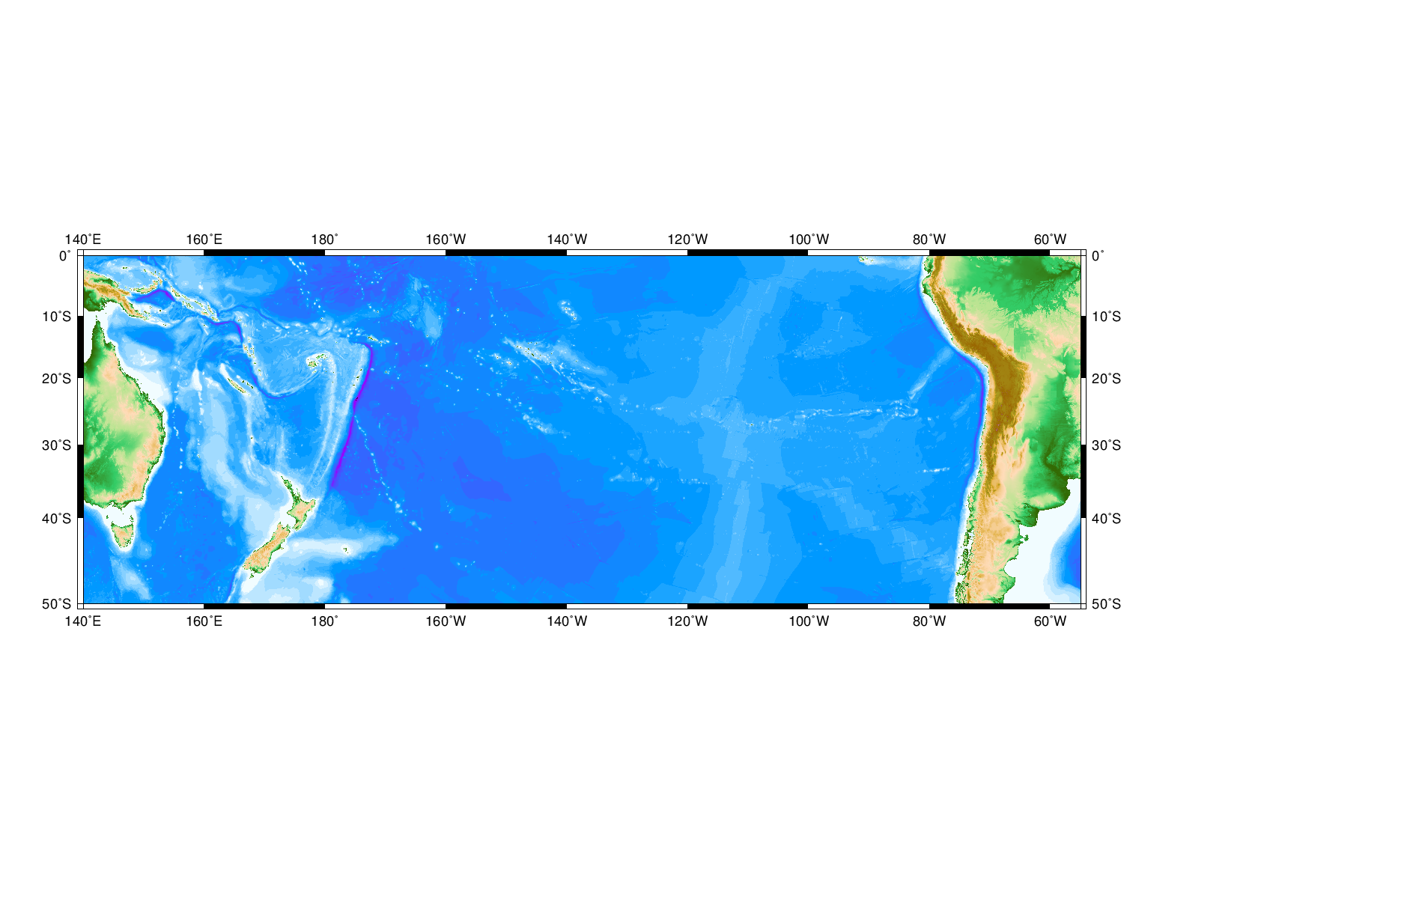
The South Pacific Regional Fishery Management Organization…

Slide 4
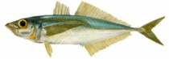
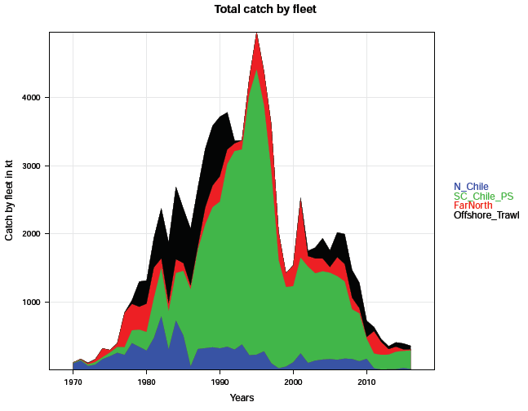
Jack mackerel fishery
Catch (thousands of t)
Far-North
Offshore
S-C Chile
N Chile
2016
Year
Notes:
57%thousands of t 2016

Slide 5
The South Pacific Regional Fishery Management Organization…
Science
Assessment and Rebuilding Plan
Feb 2006 1st international consultation in Wellington NZ
2010, 1st “Prep Con” (preparatory conference)
SPRFMO
1st Meeting
Auckland NZ
2013
7 more consultations…
2012, 3rd and last PrepCon
Assessment methods simulation testing
2008 FAO
Jack mackerel workshop Santiago
11 Science working group meetings
2 | Hobart, Australia | Nov 2006
3 | Renaca, Chile | May 2007
4 | New Caledonia | Sep 2007
5 | Guayaquil, Ecuador | Mar 2008
6 | Canberra, Australia | Oct 2008
7 | Lima, Peru | May 2009
8 | New Zealand | Nov 2009
Admin/Organizational
Notes:
11 Science working groups
Simulation testing assessment approaches

Slide 6
The South Pacific Regional Fishery Management Organization…
Science
Assessment and Rebuilding Plan
Feb 2006 1st international consultation in Wellington NZ
2010, 1st “Prep Con” (preparatory conference)
SPRFMO
1st Meeting
Auckland NZ
2013
7 more consultations…
2012, 3rd and last PrepCon
Assessment methods simulation testing
2008 FAO
Jack mackerel workshop Santiago
11 Science working group meetings
2 | Hobart, Australia | Nov 2006
3 | Renaca, Chile | May 2007
4 | New Caledonia | Sep 2007
5 | Guayaquil, Ecuador | Mar 2008
6 | Canberra, Australia | Oct 2008
7 | Lima, Peru | May 2009
8 | New Zealand | Nov 2009
Admin/Organizational
Notes:
11 Science working groups
Simulation testing assessment approaches

Slide 7
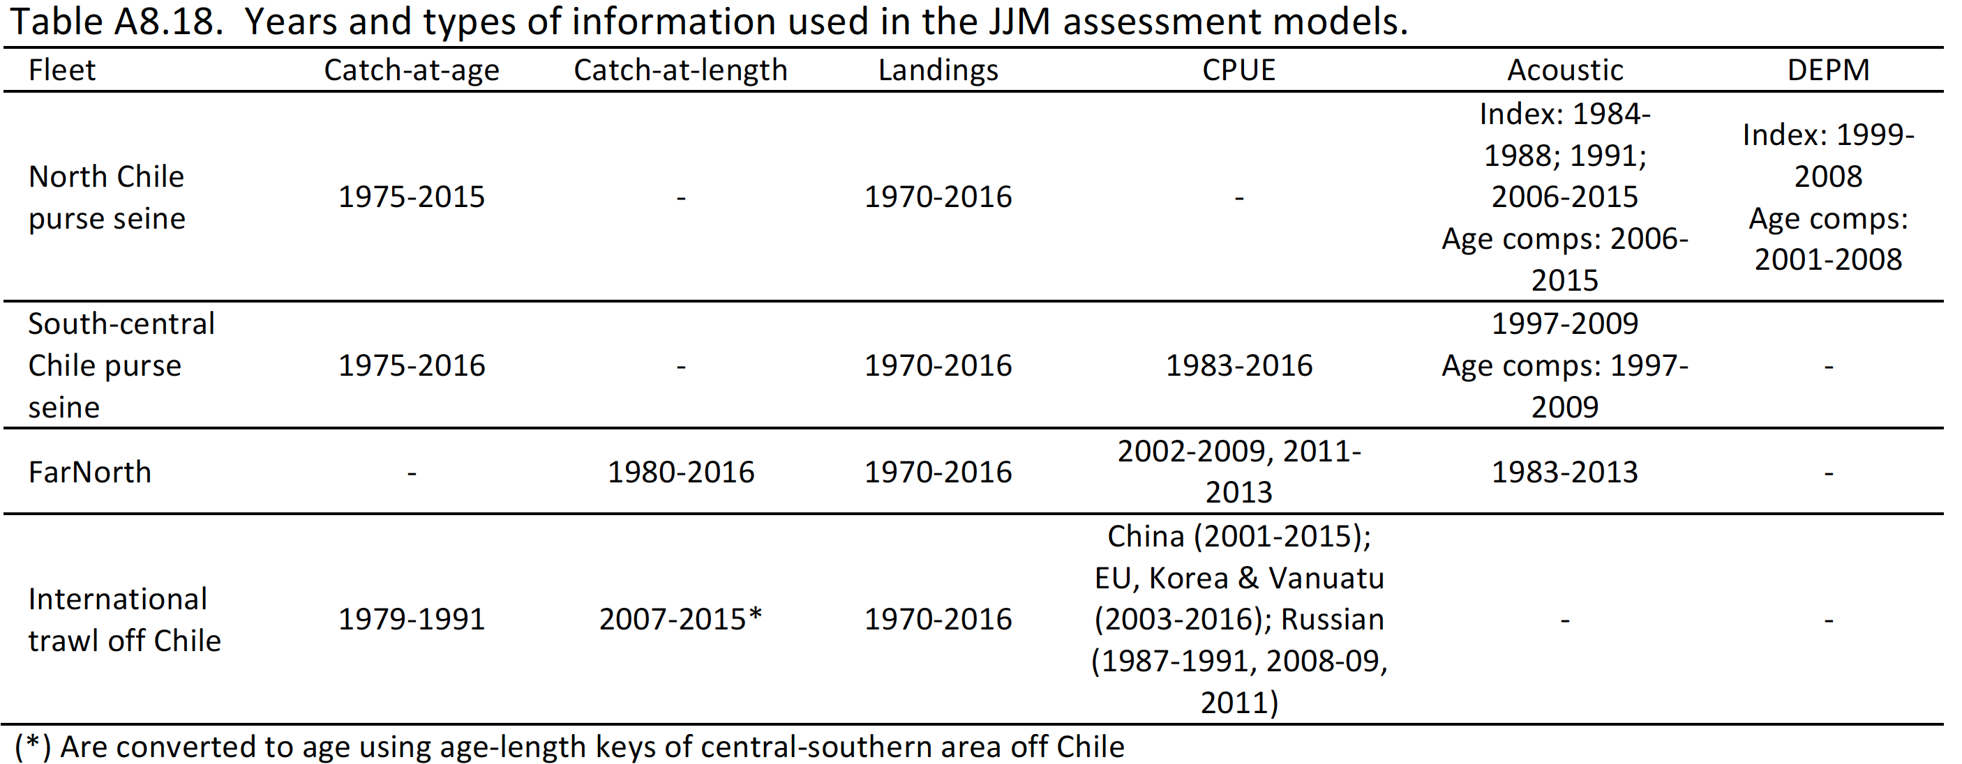
Assessment data
4 “Fleets”
Catch at age or length
Landings all years
Abundance
Indices
Notes:
Updating 2015 data
No new Peruvian data
For indices w/o new information just used previous year's mean wt-at-age
Mod0.2 uses 5 yr mean for 2015 wt age for fishery 1, 3, and 4
0.15 CV for Chilean CPUE 1983-2015
0.3 is without updated EU fishery index and data
No change in selectivity except for chilean N and CS
Relative jjmTools versus jjmR…got thing to work in jjmTest directory with jjmTools but not in jjmR…giving up on it
Cristian did 3b with new aging error
EU CPUE went from 7 years to 10 (2005, 2014 and 2015, CV=.2

Slide 8
Jack mackerel catches
Far-North
Offshore
S-C Chile
N Chile
Catch history updated, 2016 projected based on member input historic patterns
Notes:
57%

Slide 9
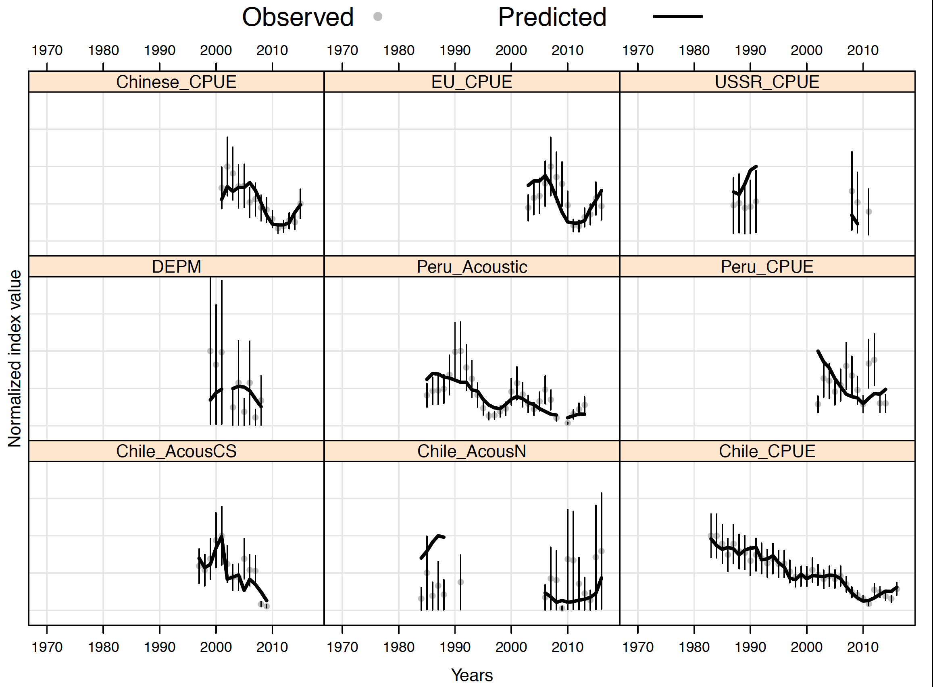
Model fit to CPUE and survey abundance indices

Slide 10
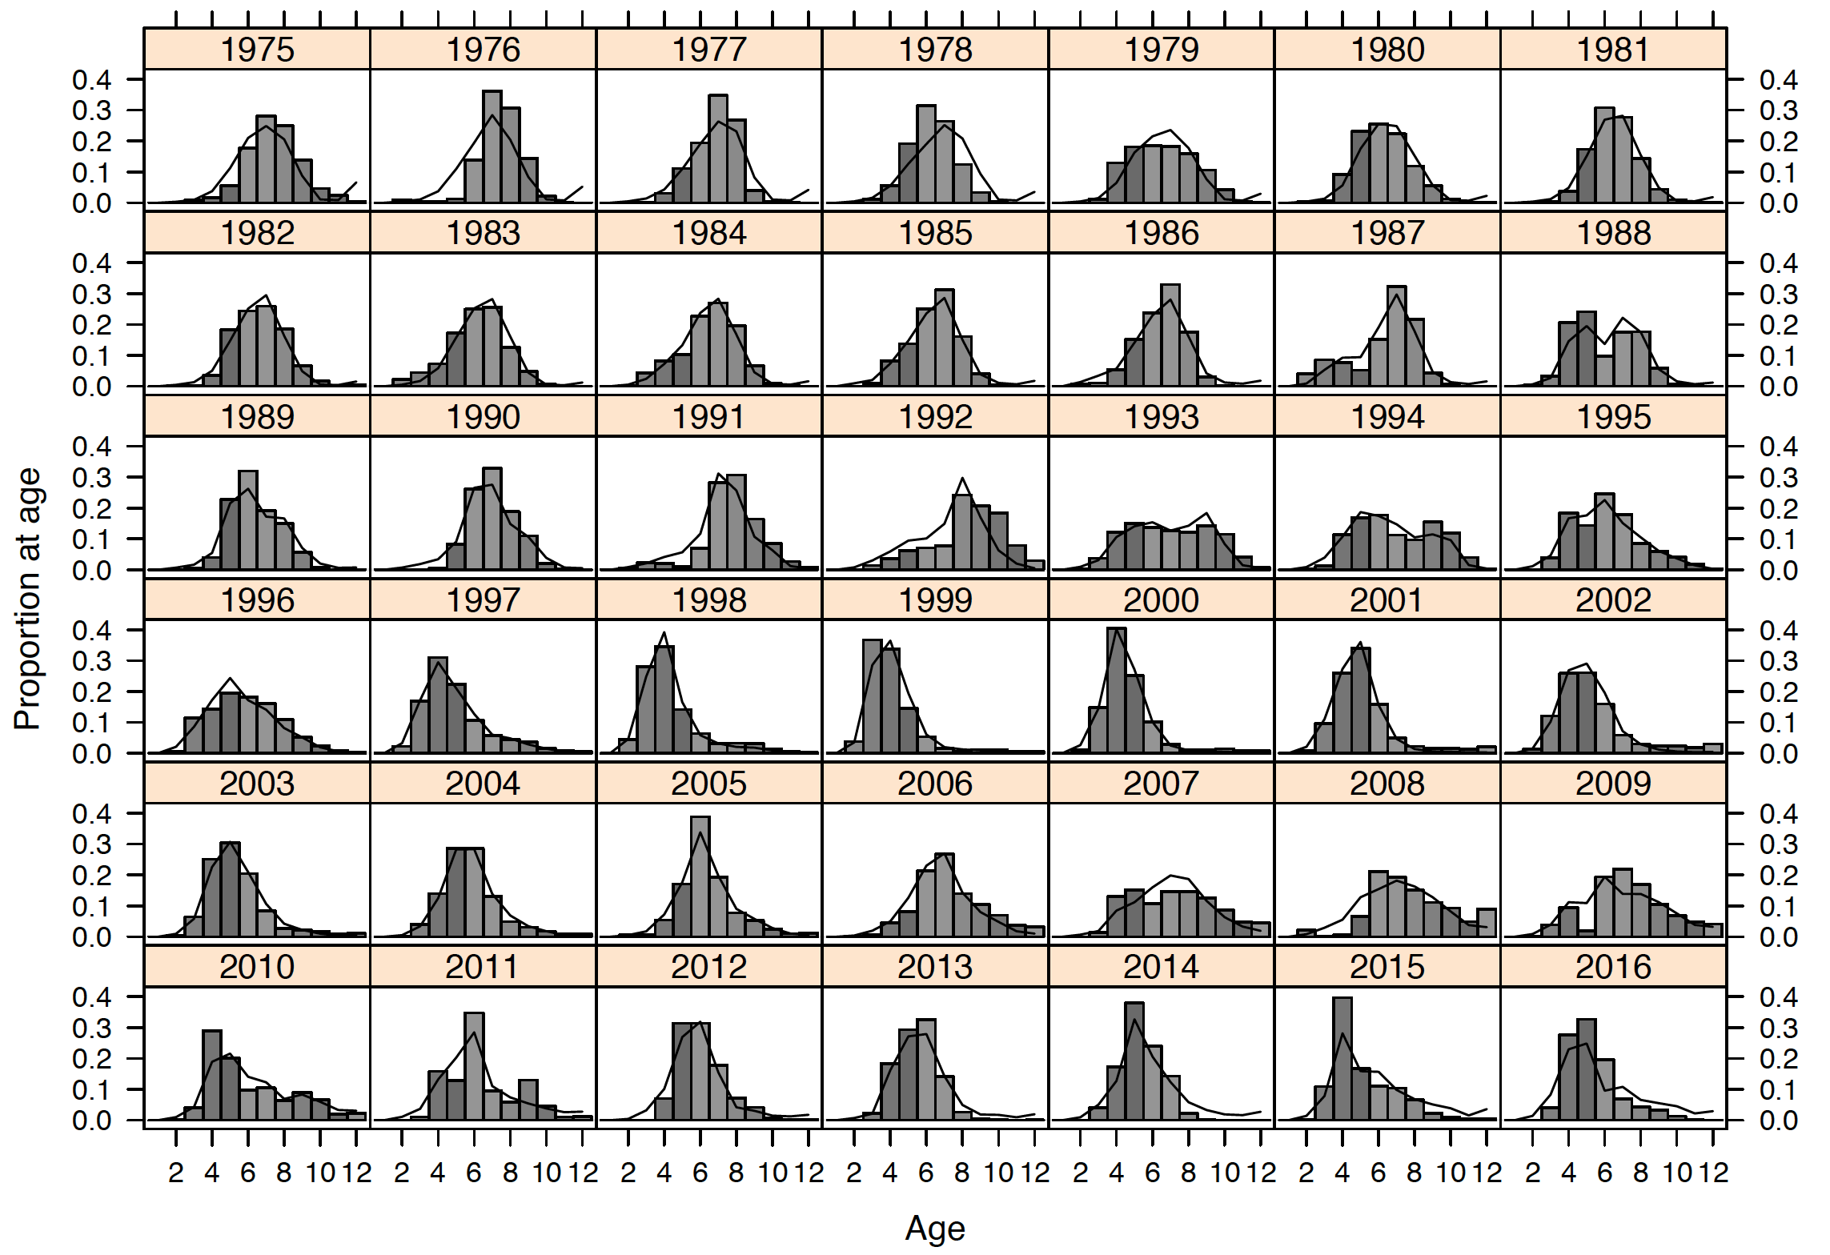
Fits to age data (S-C Chilean fleet)

Slide 11
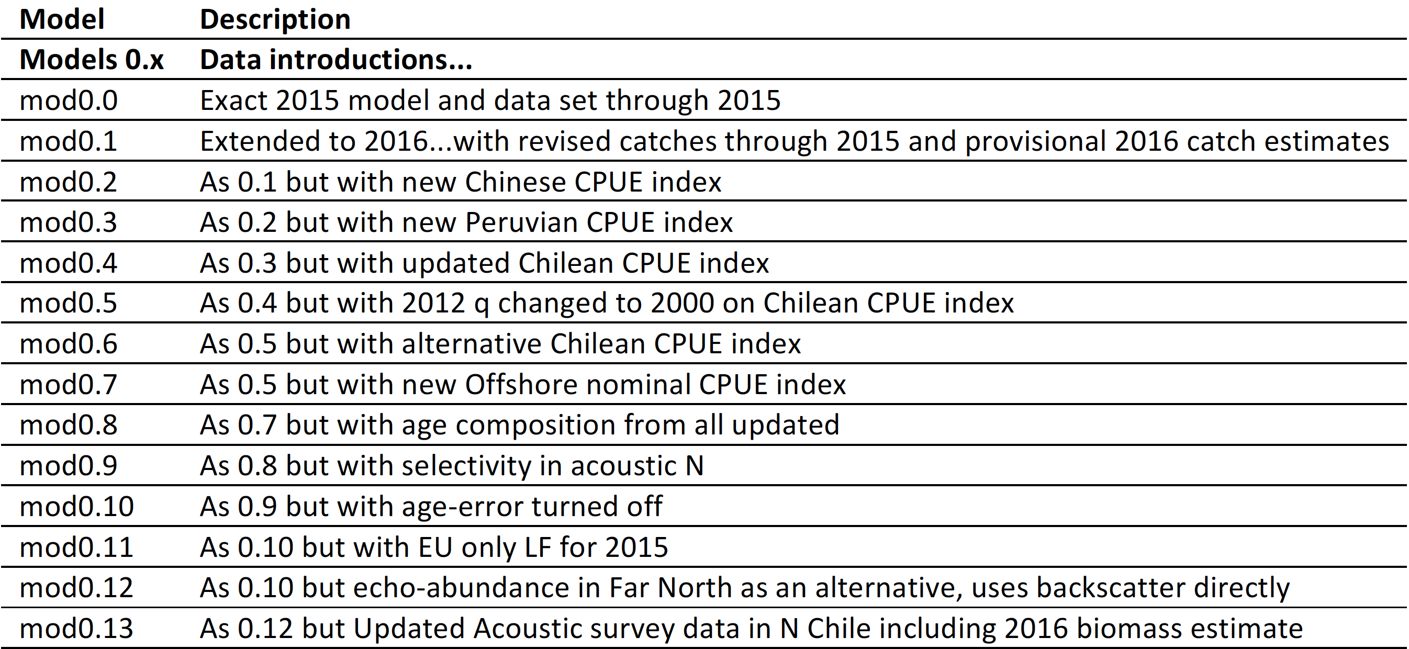
SPRFMO Jack mackerel assessment
Examine effect of new data

Slide 12
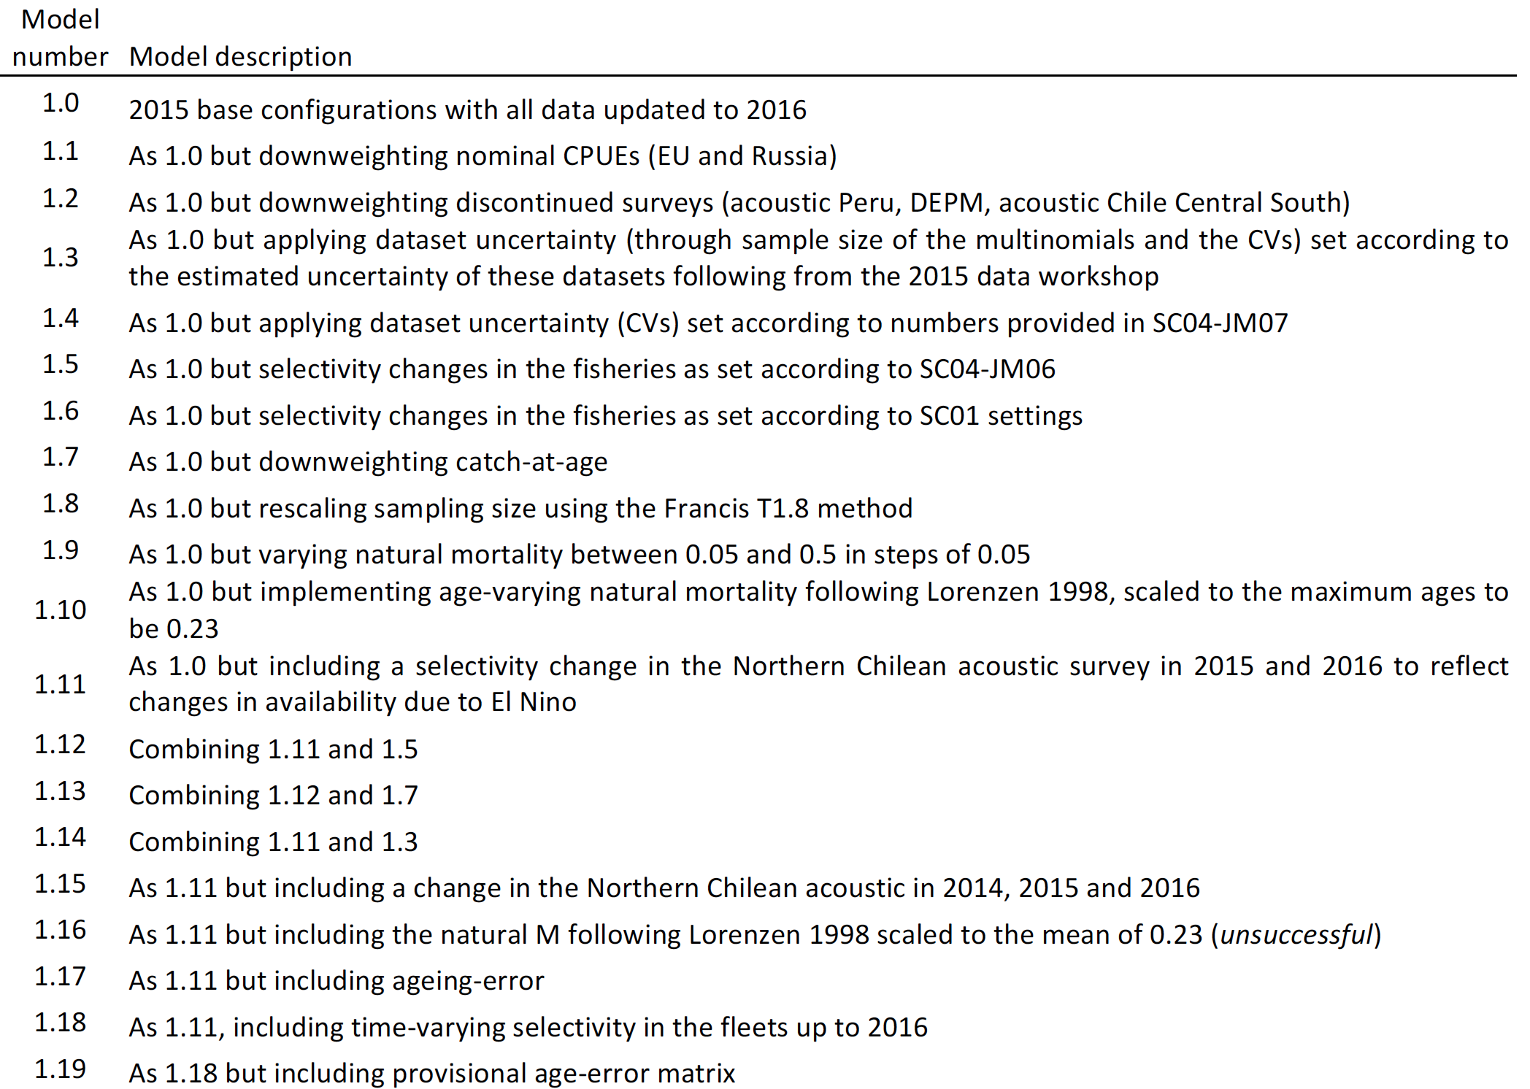
SPRFMO Jack mackerel assessment
Model configuration sensitivities

Slide 13
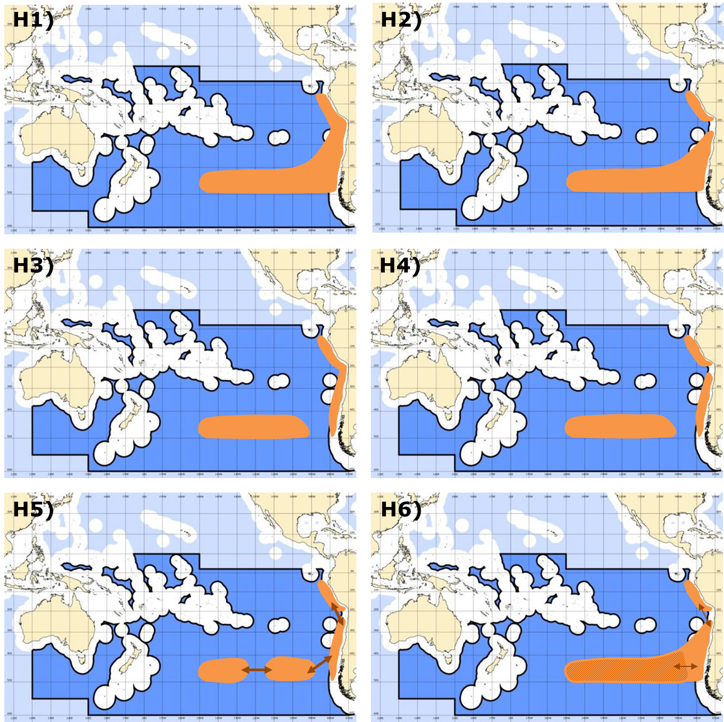
Working hypotheses on population structure

Slide 14
Stock structure hypotheses
SPRFMO Jack mackerel assessment
Hypothesis | Stock | Fleets
Hypothesis 1 (multiple stocks) | Northern Stock | Far north
 | Southern Stock | Northern Central-South Offshore fleet
Hypothesis 2 | Single stock | Far north Northern Chile Central-South Chile Offshore fleet
*Hypotheses as presented from the 2008 SPRFMO/FAO meeting
Notes:
Number of things presented during the week

Slide 15
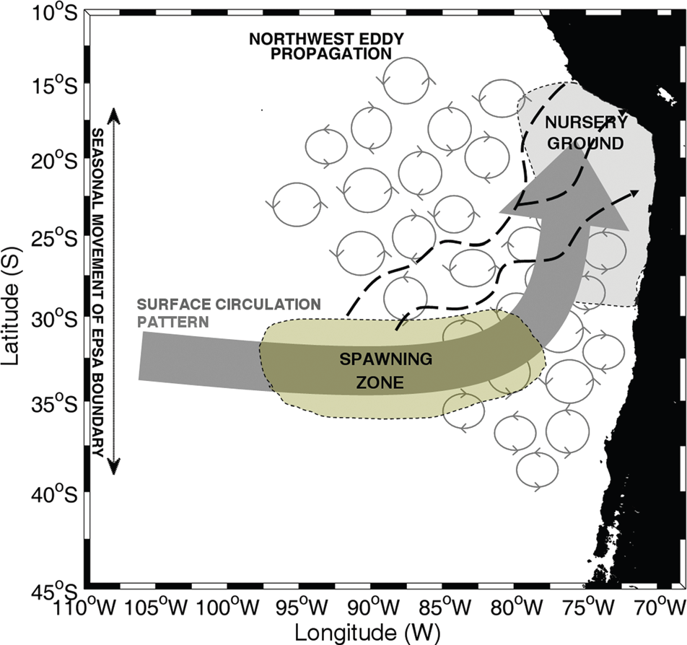

Conceptual model of connectivity
Notes:
Lots of oceanographic models etc

Slide 16
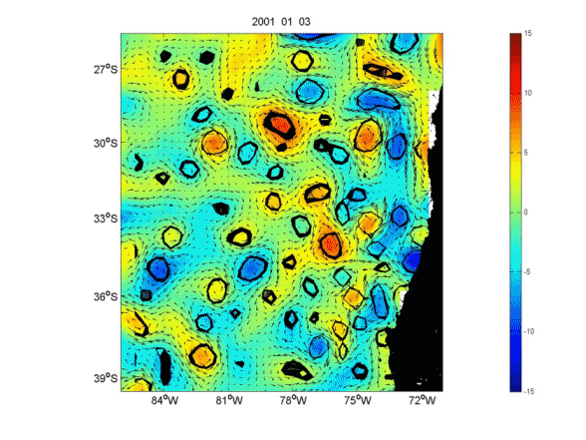
Ocean
Circulation
Model
Resolves eddies
Source: INPESCA

Slide 17
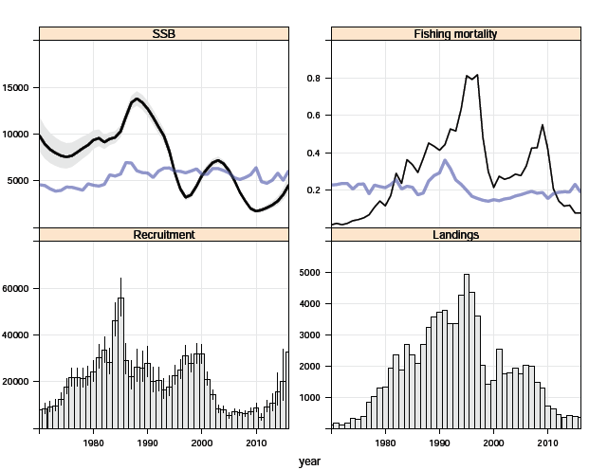
Stock summary Single stock
Spawning biomass (kt)
Fishing mortality
Recruitment
Catches (kt)
Notes:
Note confidence band on new recruits AND poor recruitment since 2003….

Slide 18
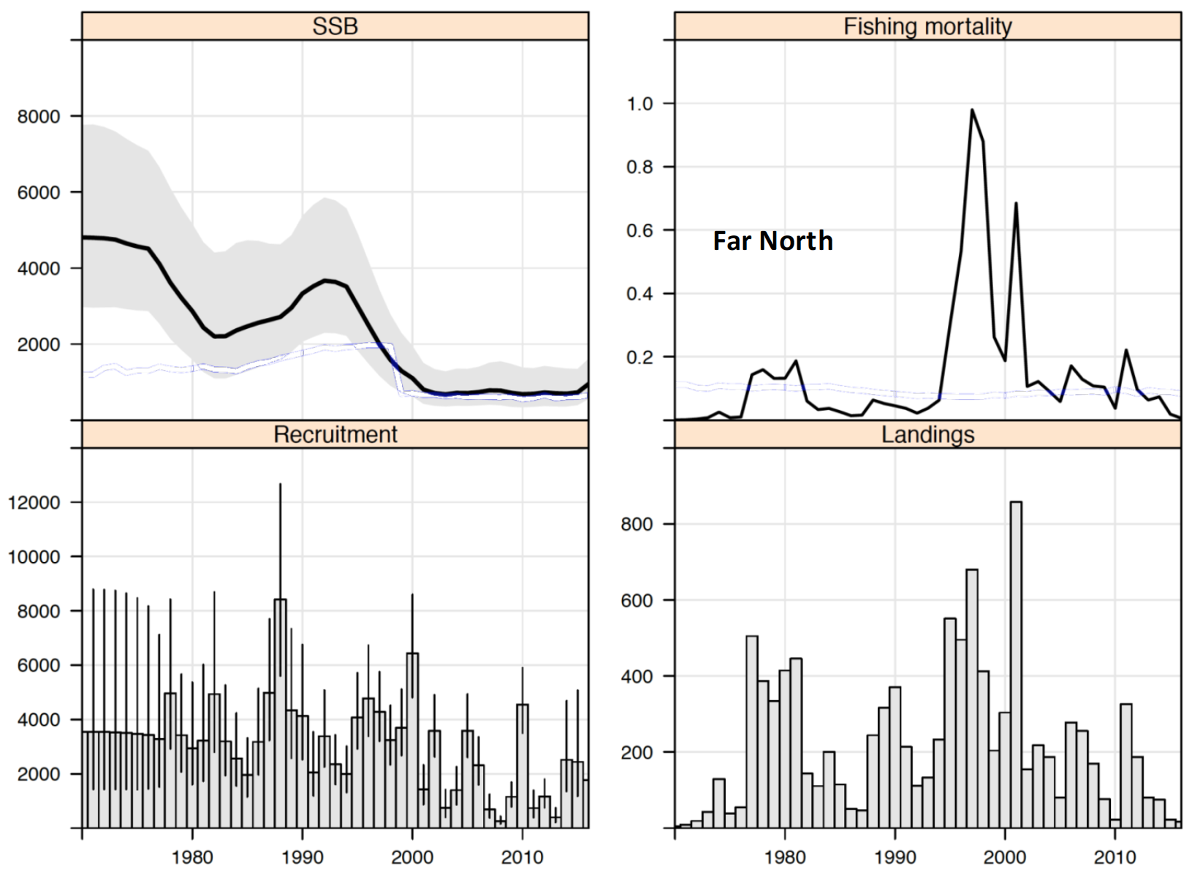
Stock summary Northern stock
Spawning biomass (kt)
Fishing mortality
Recruitment
Catches (kt)
Notes:
Note confidence band on new recruits AND poor recruitment since 2003….

Slide 19
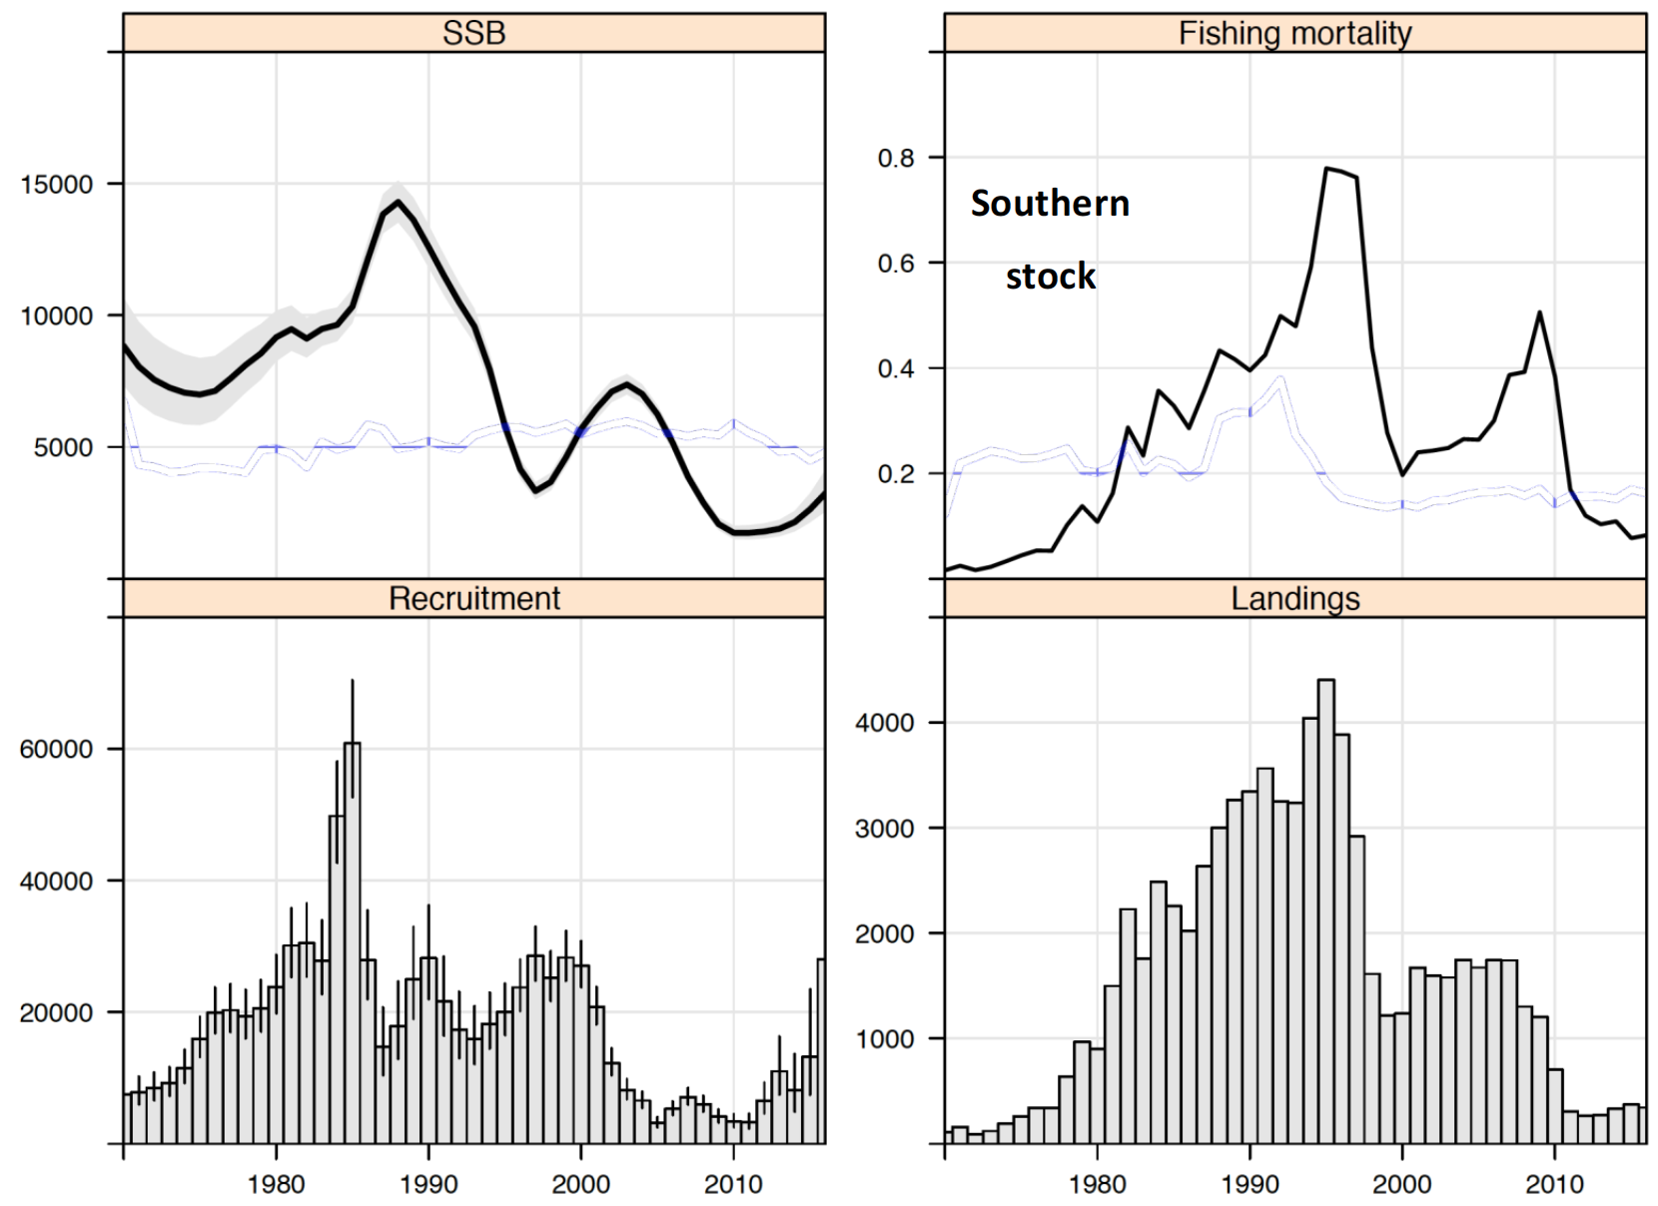
Stock summary Southern stock
Spawning biomass (kt)
Fishing mortality
Recruitment
Catches (kt)
Notes:
Note confidence band on new recruits AND poor recruitment since 2003….

Slide 20
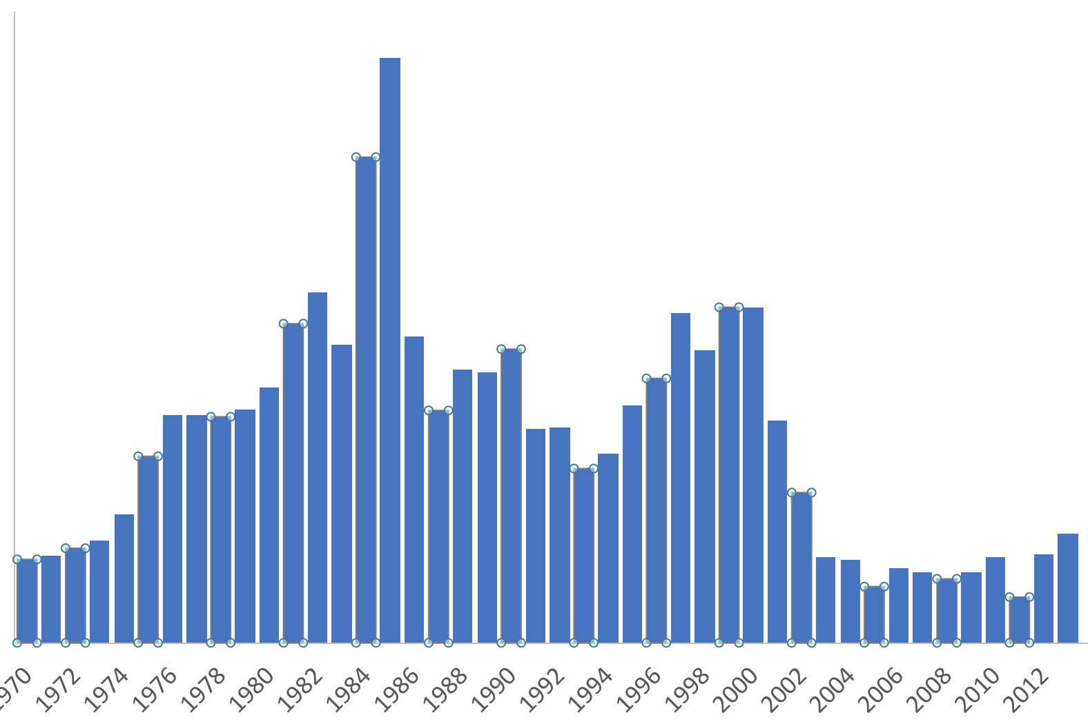
Recruitment “regimes”
SC stock status indicators
2000-2013
1970-2013
Notes:
Due to a change in “regime” for recruitment,
“the SC recommended that biomass reference points should use the entire time series recognizing that such reference points represent long-term expectations which may not be realised in the near term.”

Slide 21
Recruitment “regimes”
Stock status considerations
Considering full time series
Recruits from 2000-2013

Slide 22
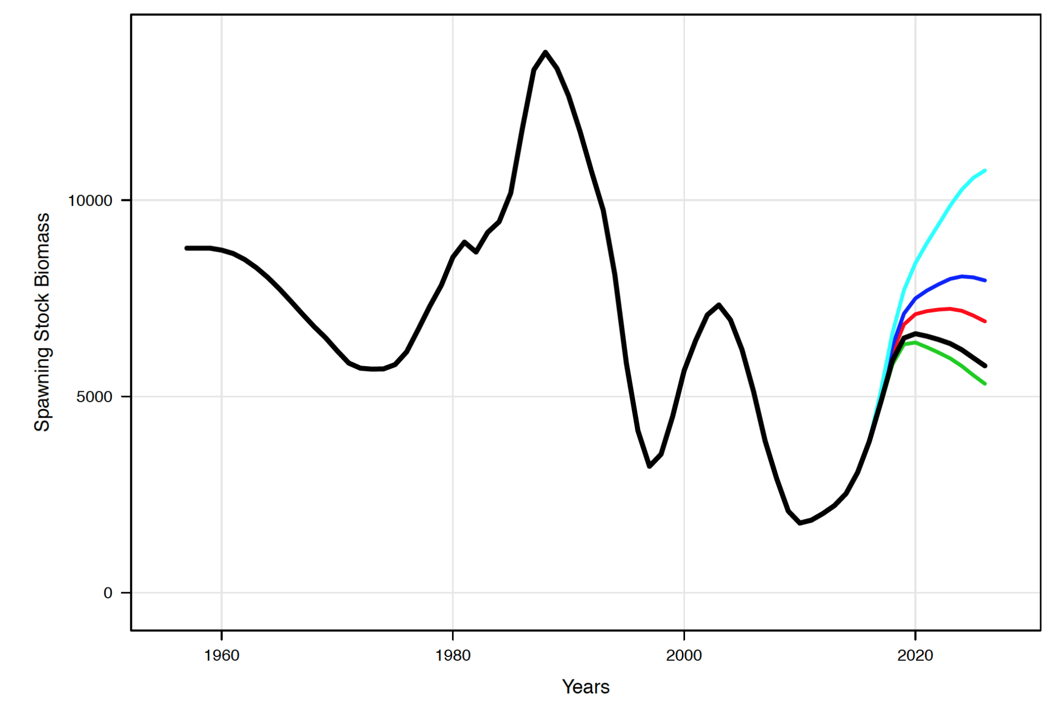
Spawning stock projections & rebuilding
No fishing
Spawning biomass (kt)
Over different
future fishing
mortality rates
Recent
recruitment
Year

Slide 23
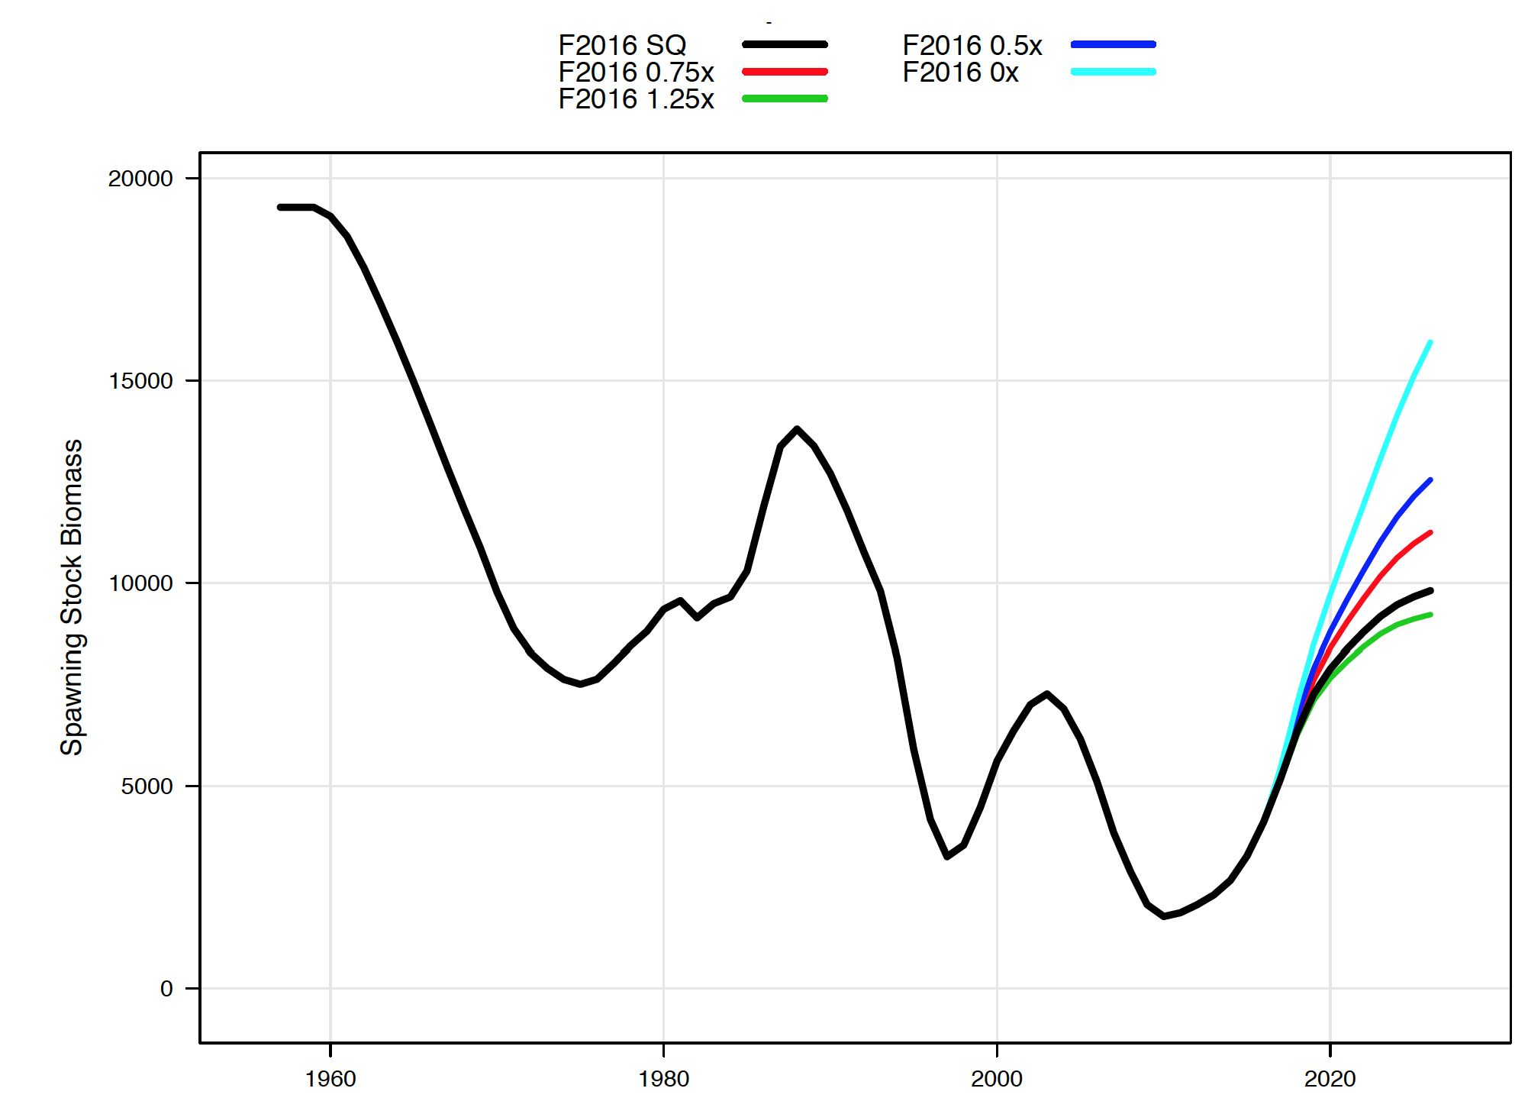
Spawning stock projections & rebuilding
No fishing
Spawning biomass (kt)
Over different
future fishing
mortality rates
Full
recruitment history
Year

Slide 24
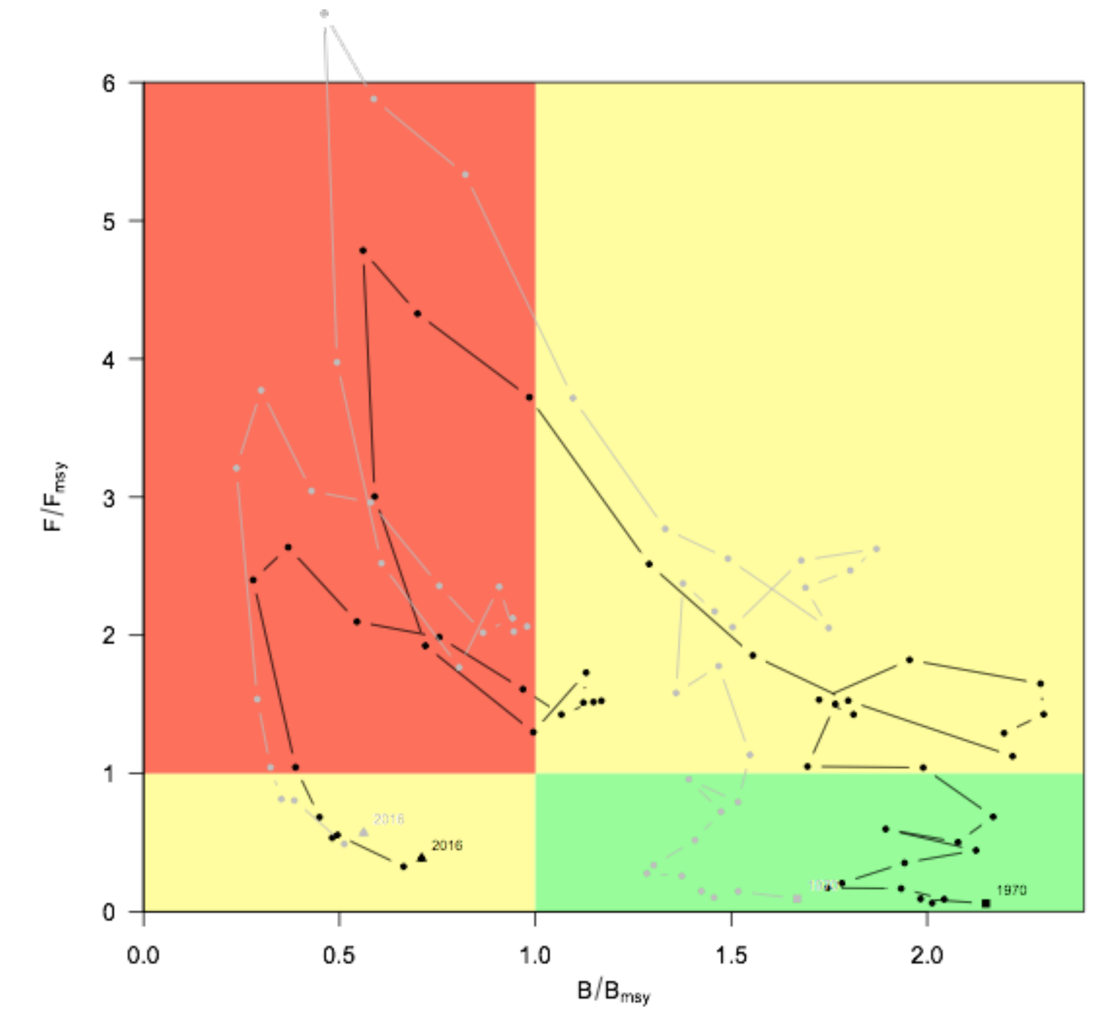
Stock status and history
F_{t}/F_{MSY}
Relative Fishing rate
B_{t}/B_{MSY}
Stock status (Biomass)
Notes:
Phase plane (or “Kobe”) plot of the estimated trajectory for jack mackerel under Model 2.0 (steepness = 0.65; black line) compared with Model 2.2 (pale line, steepness = 0.8; higher productivity) with reference points set to F_{MSY} and B_{MSY} estimated for the time series 1970-2012.

Slide 25
Chub mackerel assessment
Work from 2015

Slide 26
Chub mackerel catch time series uncertainty

Slide 27
Year/catch | Korea | Japan-Tsushima | Japan-Pacific | China(FAO) |  | Year/catch | Korea | Japan-Tsushima | Japan-Pacific | China(FAO)
1950 | 14,436 |  |  | 27,200 |  | 1983 | 122,883 | 242,000 | 391,471 | 153,932
1951 | 18,918 |  |  | 39,200 |  | 1984 | 101,714 | 198,000 | 557,086 | 123,933
1952 | 19,782 |  |  | 49,600 |  | 1985 | 68,479 | 204,000 | 448,438 | 92,573
1953 | 12,971 |  |  | 50,400 |  | 1986 | 103,511 | 193,000 | 640,616 | 132,196
1954 | 26,516 |  |  | 61,400 |  | 1987 | 101,337 | 194,000 | 348,773 | 166,039
1955 | 16,667 |  |  | 67,100 |  | 1988 | 162,828 | 240,000 | 271,925 | 240,699
1956 | 15,700 |  |  | 78,000 |  | 1989 | 163,617 | 283,000 | 134,014 | 231,625
1957 | 12,788 |  |  | 76,000 |  | 1990 | 97,227 | 131,000 | 24,013 | 196,823
1958 | 5,793 |  |  | 76,000 |  | 1991 | 91,538 | 153,000 | 22,872 | 242,639
1959 | 1,634 |  |  | 80,000 |  | 1992 | 116,422 | 143,000 | 83,898 | 243,143
1960 | 2,175 | 3,090 | 1,313 | 80,000 |  | 1993 | 174,684 | 235,000 | 404,822 | 272,604
1961 | 1,762 | 2,503 | 8,614 | 80,000 |  | 1994 | 210,442 | 339,000 | 117,863 | 336,095
1962 | 4,058 | 5,765 | 6,685 | 84,000 |  | 1995 | 200,481 | 208,000 | 146,270 | 372,038
1963 | 5,406 | 7,680 | 17,626 | 84,000 |  | 1996 | 415,003 | 411,000 | 267,194 | 374,400
1964 | 2,441 | 3,468 | 151,420 | 84,000 |  | 1997 | 160,448 | 211,000 | 334,748 | 377,940
1965 | 7,339 | 10,426 | 274,321 | 88,000 |  | 1998 | 172,925 | 165,000 | 113,258 | 341,390
1966 | 2,078 | 2,952 | 334,962 | 88,000 |  | 1999 | 177,540 | 108,000 | 70,222 | 349,154
1967 | 2,772 | 3,938 | 462,310 | 88,000 |  | 2000 | 145,908 | 89,000 | 93,707 | 300,962
1968 | 10,481 | 14,890 | 617,342 | 92,000 |  | 2001 | 203,717 | 78,000 | 55,812 | 325,563
1969 | 42,103 | 59,813 | 568,918 | 92,000 |  | 2002 | 141,751 | 86,000 | 48,192 | 353,400
1970 | 38,256 | 54,347 | 862,536 | 173,100 |  | 2003 | 122,044 | 83,000 | 76,696 | 370,747
1971 | 60,599 | 86,089 | 870,326 | 36,600 |  | 2004 | 184,274 | 85,000 | 180,667 | 382,927
1972 | 78,969 |  | 867,232 | 78,300 |  | 2005 | 135,596 | 92,000 | 226,521 | 419,002
1973 | 74,150 | 269,000 | 842,788 | 93,100 |  | 2006 | 101,427 | 91,000 | 238,989 | 403,510
1974 | 80,649 | 347,000 | 902,798 | 113,547 |  | 2007 | 143,776 | 106,000 | 182,148 | 343,821
1975 | 70,123 | 290,000 | 918,917 | 84,487 |  | 2008 | 187,240 | 121,000 | 173,401 | 592,637
1976 | 107,382 | 269,000 | 707,857 | 78,965 |  | 2009 | 117,960 | 131,000 | 127,223 | 397,010
1977 | 113,051 | 292,000 | 1,095,830 | 134,852 |  | 2010 | 94,331 | 116,000 | 131,000 | 494,691
1978 | 99,519 | 298,000 | 1,474,434 | 282,262 |  | 2011 | 151,800 | 115,000 | 103,000 | 573,458
1979 | 120,283 | 270,000 | 1,307,310 | 111,637 |  | 2012 | 125,144 | 108,000 | 120,000 | 400,000
1980 | 62,690 | 297,000 | 636,826 | 83,760 |  | 2013 | 115,427 | 64,000 | 220,000 | 400,000
1981 | 108,082 | 244,000 | 390,203 | 73,466 |  | 2014 | 130,790 | 95,667 | 147,667 | 457,819
1982 | 99,447 | 281,000 | 356,984 | 107,005
Notes:
Core data for VPA (Base model data)

Slide 28
VPA Catch Option
Year/catch | Korea | Japan-Tsushima | Japan-Pacific | China(FAO) |  | Year/catch | Korea | Japan-Tsushima | Japan-Pacific | China(FAO)
1950 | 14,436 |  |  | 27,200 |  | 1983 | 122,883 | 242,000 | 391,471 | 153,932
1951 | 18,918 |  |  | 39,200 |  | 1984 | 101,714 | 198,000 | 557,086 | 123,933
1952 | 19,782 |  |  | 49,600 |  | 1985 | 68,479 | 204,000 | 448,438 | 92,573
1953 | 12,971 |  |  | 50,400 |  | 1986 | 103,511 | 193,000 | 640,616 | 132,196
1954 | 26,516 |  |  | 61,400 |  | 1987 | 101,337 | 194,000 | 348,773 | 166,039
1955 | 16,667 |  |  | 67,100 |  | 1988 | 162,828 | 240,000 | 271,925 | 240,699
1956 | 15,700 |  |  | 78,000 |  | 1989 | 163,617 | 283,000 | 134,014 | 231,625
1957 | 12,788 |  |  | 76,000 |  | 1990 | 97,227 | 131,000 | 24,013 | 196,823
1958 | 5,793 |  |  | 76,000 |  | 1991 | 91,538 | 153,000 | 22,872 | 242,639
1959 | 1,634 |  |  | 80,000 |  | 1992 | 116,422 | 143,000 | 83,898 | 243,143
1960 | 2,175 | 3,090 | 1,313 | 80,000 |  | 1993 | 174,684 | 235,000 | 404,822 | 272,604
1961 | 1,762 | 2,503 | 8,614 | 80,000 |  | 1994 | 210,442 | 339,000 | 117,863 | 336,095
1962 | 4,058 | 5,765 | 6,685 | 84,000 |  | 1995 | 200,481 | 208,000 | 146,270 | 372,038
1963 | 5,406 | 7,680 | 17,626 | 84,000 |  | 1996 | 415,003 | 411,000 | 267,194 | 374,400
1964 | 2,441 | 3,468 | 151,420 | 84,000 |  | 1997 | 160,448 | 211,000 | 334,748 | 377,940
1965 | 7,339 | 10,426 | 274,321 | 88,000 |  | 1998 | 172,925 | 165,000 | 113,258 | 341,390
1966 | 2,078 | 2,952 | 334,962 | 88,000 |  | 1999 | 177,540 | 108,000 | 70,222 | 349,154
1967 | 2,772 | 3,938 | 462,310 | 88,000 |  | 2000 | 145,908 | 89,000 | 93,707 | 300,962
1968 | 10,481 | 14,890 | 617,342 | 92,000 |  | 2001 | 203,717 | 78,000 | 55,812 | 325,563
1969 | 42,103 | 59,813 | 568,918 | 92,000 |  | 2002 | 141,751 | 86,000 | 48,192 | 353,400
1970 | 38,256 | 54,347 | 862,536 | 173,100 |  | 2003 | 122,044 | 83,000 | 76,696 | 370,747
1971 | 60,599 | 86,089 | 870,326 | 36,600 |  | 2004 | 184,274 | 85,000 | 180,667 | 382,927
1972 | 78,969 |  | 867,232 | 78,300 |  | 2005 | 135,596 | 92,000 | 226,521 | 419,002
1973 | 74,150 | 269,000 | 842,788 | 93,100 |  | 2006 | 101,427 | 91,000 | 238,989 | 403,510
1974 | 80,649 | 347,000 | 902,798 | 113,547 |  | 2007 | 143,776 | 106,000 | 182,148 | 343,821
1975 | 70,123 | 290,000 | 918,917 | 84,487 |  | 2008 | 187,240 | 121,000 | 173,401 | 592,637
1976 | 107,382 | 269,000 | 707,857 | 78,965 |  | 2009 | 117,960 | 131,000 | 127,223 | 397,010
1977 | 113,051 | 292,000 | 1,095,830 | 134,852 |  | 2010 | 94,331 | 116,000 | 131,000 | 494,691
1978 | 99,519 | 298,000 | 1,474,434 | 282,262 |  | 2011 | 151,800 | 115,000 | 103,000 | 573,458
1979 | 120,283 | 270,000 | 1,307,310 | 111,637 |  | 2012 | 125,144 | 108,000 | 120,000 | 400,000
1980 | 62,690 | 297,000 | 636,826 | 83,760 |  | 2013 | 115,427 | 64,000 | 220,000 | 400,000
1981 | 108,082 | 244,000 | 390,203 | 73,466 |  | 2014 | 130,790 | 95,667 | 147,667 | 457,819
1982 | 99,447 | 281,000 | 356,984 | 107,005

Slide 29
Year/catch | Korea | Japan-Tsushima | Japan-Pacific | China(FAO) |  | Year/catch | Korea | Japan-Tsushima | Japan-Pacific | China(FAO)
1950 | 14,436 |  |  | 27,200 |  | 1983 | 122,883 | 242,000 | 391,471 | 153,932
1951 | 18,918 |  |  | 39,200 |  | 1984 | 101,714 | 198,000 | 557,086 | 123,933
1952 | 19,782 |  |  | 49,600 |  | 1985 | 68,479 | 204,000 | 448,438 | 92,573
1953 | 12,971 |  |  | 50,400 |  | 1986 | 103,511 | 193,000 | 640,616 | 132,196
1954 | 26,516 |  |  | 61,400 |  | 1987 | 101,337 | 194,000 | 348,773 | 166,039
1955 | 16,667 |  |  | 67,100 |  | 1988 | 162,828 | 240,000 | 271,925 | 240,699
1956 | 15,700 |  |  | 78,000 |  | 1989 | 163,617 | 283,000 | 134,014 | 231,625
1957 | 12,788 |  |  | 76,000 |  | 1990 | 97,227 | 131,000 | 24,013 | 196,823
1958 | 5,793 |  |  | 76,000 |  | 1991 | 91,538 | 153,000 | 22,872 | 242,639
1959 | 1,634 |  |  | 80,000 |  | 1992 | 116,422 | 143,000 | 83,898 | 243,143
1960 | 2,175 | 3,090 | 1,313 | 80,000 |  | 1993 | 174,684 | 235,000 | 404,822 | 272,604
1961 | 1,762 | 2,503 | 8,614 | 80,000 |  | 1994 | 210,442 | 339,000 | 117,863 | 336,095
1962 | 4,058 | 5,765 | 6,685 | 84,000 |  | 1995 | 200,481 | 208,000 | 146,270 | 372,038
1963 | 5,406 | 7,680 | 17,626 | 84,000 |  | 1996 | 415,003 | 411,000 | 267,194 | 374,400
1964 | 2,441 | 3,468 | 151,420 | 84,000 |  | 1997 | 160,448 | 211,000 | 334,748 | 377,940
1965 | 7,339 | 10,426 | 274,321 | 88,000 |  | 1998 | 172,925 | 165,000 | 113,258 | 341,390
1966 | 2,078 | 2,952 | 334,962 | 88,000 |  | 1999 | 177,540 | 108,000 | 70,222 | 349,154
1967 | 2,772 | 3,938 | 462,310 | 88,000 |  | 2000 | 145,908 | 89,000 | 93,707 | 300,962
1968 | 10,481 | 14,890 | 617,342 | 92,000 |  | 2001 | 203,717 | 78,000 | 55,812 | 325,563
1969 | 42,103 | 59,813 | 568,918 | 92,000 |  | 2002 | 141,751 | 86,000 | 48,192 | 353,400
1970 | 38,256 | 54,347 | 862,536 | 173,100 |  | 2003 | 122,044 | 83,000 | 76,696 | 370,747
1971 | 60,599 | 86,089 | 870,326 | 36,600 |  | 2004 | 184,274 | 85,000 | 180,667 | 382,927
1972 | 78,969 |  | 867,232 | 78,300 |  | 2005 | 135,596 | 92,000 | 226,521 | 419,002
1973 | 74,150 | 269,000 | 842,788 | 93,100 |  | 2006 | 101,427 | 91,000 | 238,989 | 403,510
1974 | 80,649 | 347,000 | 902,798 | 113,547 |  | 2007 | 143,776 | 106,000 | 182,148 | 343,821
1975 | 70,123 | 290,000 | 918,917 | 84,487 |  | 2008 | 187,240 | 121,000 | 173,401 | 592,637
1976 | 107,382 | 269,000 | 707,857 | 78,965 |  | 2009 | 117,960 | 131,000 | 127,223 | 397,010
1977 | 113,051 | 292,000 | 1,095,830 | 134,852 |  | 2010 | 94,331 | 116,000 | 131,000 | 494,691
1978 | 99,519 | 298,000 | 1,474,434 | 282,262 |  | 2011 | 151,800 | 115,000 | 103,000 | 573,458
1979 | 120,283 | 270,000 | 1,307,310 | 111,637 |  | 2012 | 125,144 | 108,000 | 120,000 | 400,000
1980 | 62,690 | 297,000 | 636,826 | 83,760 |  | 2013 | 115,427 | 64,000 | 220,000 | 400,000
1981 | 108,082 | 244,000 | 390,203 | 73,466 |  | 2014 | 130,790 | 95,667 | 147,667 | 457,819
1982 | 99,447 | 281,000 | 356,984 | 107,005

Slide 30
Year/catch | Korea | Japan-Tsushima | Japan-Pacific | China(FAO) |  | Year/catch | Korea | Japan-Tsushima | Japan-Pacific | China(FAO)
1950 | 14,436 |  |  | 27,200 |  | 1983 | 122,883 | 242,000 | 391,471 | 153,932
1951 | 18,918 |  |  | 39,200 |  | 1984 | 101,714 | 198,000 | 557,086 | 123,933
1952 | 19,782 |  |  | 49,600 |  | 1985 | 68,479 | 204,000 | 448,438 | 92,573
1953 | 12,971 |  |  | 50,400 |  | 1986 | 103,511 | 193,000 | 640,616 | 132,196
1954 | 26,516 |  |  | 61,400 |  | 1987 | 101,337 | 194,000 | 348,773 | 166,039
1955 | 16,667 |  |  | 67,100 |  | 1988 | 162,828 | 240,000 | 271,925 | 240,699
1956 | 15,700 |  |  | 78,000 |  | 1989 | 163,617 | 283,000 | 134,014 | 231,625
1957 | 12,788 |  |  | 76,000 |  | 1990 | 97,227 | 131,000 | 24,013 | 196,823
1958 | 5,793 |  |  | 76,000 |  | 1991 | 91,538 | 153,000 | 22,872 | 242,639
1959 | 1,634 |  |  | 80,000 |  | 1992 | 116,422 | 143,000 | 83,898 | 243,143
1960 | 2,175 | 3,090 | 1,313 | 80,000 |  | 1993 | 174,684 | 235,000 | 404,822 | 272,604
1961 | 1,762 | 2,503 | 8,614 | 80,000 |  | 1994 | 210,442 | 339,000 | 117,863 | 336,095
1962 | 4,058 | 5,765 | 6,685 | 84,000 |  | 1995 | 200,481 | 208,000 | 146,270 | 372,038
1963 | 5,406 | 7,680 | 17,626 | 84,000 |  | 1996 | 415,003 | 411,000 | 267,194 | 374,400
1964 | 2,441 | 3,468 | 151,420 | 84,000 |  | 1997 | 160,448 | 211,000 | 334,748 | 377,940
1965 | 7,339 | 10,426 | 274,321 | 88,000 |  | 1998 | 172,925 | 165,000 | 113,258 | 341,390
1966 | 2,078 | 2,952 | 334,962 | 88,000 |  | 1999 | 177,540 | 108,000 | 70,222 | 349,154
1967 | 2,772 | 3,938 | 462,310 | 88,000 |  | 2000 | 145,908 | 89,000 | 93,707 | 300,962
1968 | 10,481 | 14,890 | 617,342 | 92,000 |  | 2001 | 203,717 | 78,000 | 55,812 | 325,563
1969 | 42,103 | 59,813 | 568,918 | 92,000 |  | 2002 | 141,751 | 86,000 | 48,192 | 353,400
1970 | 38,256 | 54,347 | 862,536 | 173,100 |  | 2003 | 122,044 | 83,000 | 76,696 | 370,747
1971 | 60,599 | 86,089 | 870,326 | 36,600 |  | 2004 | 184,274 | 85,000 | 180,667 | 382,927
1972 | 78,969 |  | 867,232 | 78,300 |  | 2005 | 135,596 | 92,000 | 226,521 | 419,002
1973 | 74,150 | 269,000 | 842,788 | 93,100 |  | 2006 | 101,427 | 91,000 | 238,989 | 403,510
1974 | 80,649 | 347,000 | 902,798 | 113,547 |  | 2007 | 143,776 | 106,000 | 182,148 | 343,821
1975 | 70,123 | 290,000 | 918,917 | 84,487 |  | 2008 | 187,240 | 121,000 | 173,401 | 592,637
1976 | 107,382 | 269,000 | 707,857 | 78,965 |  | 2009 | 117,960 | 131,000 | 127,223 | 397,010
1977 | 113,051 | 292,000 | 1,095,830 | 134,852 |  | 2010 | 94,331 | 116,000 | 131,000 | 494,691
1978 | 99,519 | 298,000 | 1,474,434 | 282,262 |  | 2011 | 151,800 | 115,000 | 103,000 | 573,458
1979 | 120,283 | 270,000 | 1,307,310 | 111,637 |  | 2012 | 125,144 | 108,000 | 120,000 | 400,000
1980 | 62,690 | 297,000 | 636,826 | 83,760 |  | 2013 | 115,427 | 64,000 | 220,000 | 400,000
1981 | 108,082 | 244,000 | 390,203 | 73,466 |  | 2014 | 130,790 | 95,667 | 147,667 | 457,819
1982 | 99,447 | 281,000 | 356,984 | 107,005

Slide 31
Year/catch | Korea | Japan-Tsushima | Japan-Pacific | China(FAO) |  | Year/catch | Korea | Japan-Tsushima | Japan-Pacific | China(FAO)
1950 | 14,436 | 20,508 |  | 27,200 |  | 1983 | 122,883 | 242,000 | 391,471 | 153,932
1951 | 18,918 | 26,875 |  | 39,200 |  | 1984 | 101,714 | 198,000 | 557,086 | 123,933
1952 | 19,782 | 28,103 |  | 49,600 |  | 1985 | 68,479 | 204,000 | 448,438 | 92,573
1953 | 12,971 | 18,427 |  | 50,400 |  | 1986 | 103,511 | 193,000 | 640,616 | 132,196
1954 | 26,516 | 37,669 |  | 61,400 |  | 1987 | 101,337 | 194,000 | 348,773 | 166,039
1955 | 16,667 | 23,678 |  | 67,100 |  | 1988 | 162,828 | 240,000 | 271,925 | 240,699
1956 | 15,700 | 22,304 |  | 78,000 |  | 1989 | 163,617 | 283,000 | 134,014 | 231,625
1957 | 12,788 | 18,167 |  | 76,000 |  | 1990 | 97,227 | 131,000 | 24,013 | 196,823
1958 | 5,793 | 8,230 |  | 76,000 |  | 1991 | 91,538 | 153,000 | 22,872 | 242,639
1959 | 1,634 | 2,321 |  | 80,000 |  | 1992 | 116,422 | 143,000 | 83,898 | 243,143
1960 | 2,175 | 3,090 | 1,313 | 80,000 |  | 1993 | 174,684 | 235,000 | 404,822 | 272,604
1961 | 1,762 | 2,503 | 8,614 | 80,000 |  | 1994 | 210,442 | 339,000 | 117,863 | 336,095
1962 | 4,058 | 5,765 | 6,685 | 84,000 |  | 1995 | 200,481 | 208,000 | 146,270 | 372,038
1963 | 5,406 | 7,680 | 17,626 | 84,000 |  | 1996 | 415,003 | 411,000 | 267,194 | 374,400
1964 | 2,441 | 3,468 | 151,420 | 84,000 |  | 1997 | 160,448 | 211,000 | 334,748 | 377,940
1965 | 7,339 | 10,426 | 274,321 | 88,000 |  | 1998 | 172,925 | 165,000 | 113,258 | 341,390
1966 | 2,078 | 2,952 | 334,962 | 88,000 |  | 1999 | 177,540 | 108,000 | 70,222 | 349,154
1967 | 2,772 | 3,938 | 462,310 | 88,000 |  | 2000 | 145,908 | 89,000 | 93,707 | 300,962
1968 | 10,481 | 14,890 | 617,342 | 92,000 |  | 2001 | 203,717 | 78,000 | 55,812 | 325,563
1969 | 42,103 | 59,813 | 568,918 | 92,000 |  | 2002 | 141,751 | 86,000 | 48,192 | 353,400
1970 | 38,256 | 54,347 | 862,536 | 173,100 |  | 2003 | 122,044 | 83,000 | 76,696 | 370,747
1971 | 60,599 | 86,089 | 870,326 | 36,600 |  | 2004 | 184,274 | 85,000 | 180,667 | 382,927
1972 | 78,969 | 112,185 | 867,232 | 78,300 |  | 2005 | 135,596 | 92,000 | 226,521 | 419,002
1973 | 74,150 | 269,000 | 842,788 | 93,100 |  | 2006 | 101,427 | 91,000 | 238,989 | 403,510
1974 | 80,649 | 347,000 | 902,798 | 113,547 |  | 2007 | 143,776 | 106,000 | 182,148 | 343,821
1975 | 70,123 | 290,000 | 918,917 | 84,487 |  | 2008 | 187,240 | 121,000 | 173,401 | 592,637
1976 | 107,382 | 269,000 | 707,857 | 78,965 |  | 2009 | 117,960 | 131,000 | 127,223 | 397,010
1977 | 113,051 | 292,000 | 1,095,830 | 134,852 |  | 2010 | 94,331 | 116,000 | 131,000 | 494,691
1978 | 99,519 | 298,000 | 1,474,434 | 282,262 |  | 2011 | 151,800 | 115,000 | 103,000 | 573,458
1979 | 120,283 | 270,000 | 1,307,310 | 111,637 |  | 2012 | 125,144 | 108,000 | 120,000 | 400,000
1980 | 62,690 | 297,000 | 636,826 | 83,760 |  | 2013 | 115,427 | 64,000 | 220,000 | 400,000
1981 | 108,082 | 244,000 | 390,203 | 73,466 |  | 2014 | 130,790 | 95,667 | 147,667 | 457,819
1982 | 99,447 | 281,000 | 356,984 | 107,005

Slide 32
Catch option 1
Year/catch | Korea | Japan-Tsushima | Japan-Pacific | China(FAO) |  | Year/catch | Korea | Japan-Tsushima | Japan-Pacific | China(FAO)
1950 | 14,436 | 20,508 |  | 27,200 |  | 1983 | 122,883 | 242,000 | 391,471 | 153,932
1951 | 18,918 | 26,875 |  | 39,200 |  | 1984 | 101,714 | 198,000 | 557,086 | 123,933
1952 | 19,782 | 28,103 |  | 49,600 |  | 1985 | 68,479 | 204,000 | 448,438 | 92,573
1953 | 12,971 | 18,427 |  | 50,400 |  | 1986 | 103,511 | 193,000 | 640,616 | 132,196
1954 | 26,516 | 37,669 |  | 61,400 |  | 1987 | 101,337 | 194,000 | 348,773 | 166,039
1955 | 16,667 | 23,678 |  | 67,100 |  | 1988 | 162,828 | 240,000 | 271,925 | 240,699
1956 | 15,700 | 22,304 |  | 78,000 |  | 1989 | 163,617 | 283,000 | 134,014 | 231,625
1957 | 12,788 | 18,167 |  | 76,000 |  | 1990 | 97,227 | 131,000 | 24,013 | 196,823
1958 | 5,793 | 8,230 |  | 76,000 |  | 1991 | 91,538 | 153,000 | 22,872 | 242,639
1959 | 1,634 | 2,321 |  | 80,000 |  | 1992 | 116,422 | 143,000 | 83,898 | 243,143
1960 | 2,175 | 3,090 | 1,313 | 80,000 |  | 1993 | 174,684 | 235,000 | 404,822 | 272,604
1961 | 1,762 | 2,503 | 8,614 | 80,000 |  | 1994 | 210,442 | 339,000 | 117,863 | 336,095
1962 | 4,058 | 5,765 | 6,685 | 84,000 |  | 1995 | 200,481 | 208,000 | 146,270 | 372,038
1963 | 5,406 | 7,680 | 17,626 | 84,000 |  | 1996 | 415,003 | 411,000 | 267,194 | 374,400
1964 | 2,441 | 3,468 | 151,420 | 84,000 |  | 1997 | 160,448 | 211,000 | 334,748 | 377,940
1965 | 7,339 | 10,426 | 274,321 | 88,000 |  | 1998 | 172,925 | 165,000 | 113,258 | 341,390
1966 | 2,078 | 2,952 | 334,962 | 88,000 |  | 1999 | 177,540 | 108,000 | 70,222 | 349,154
1967 | 2,772 | 3,938 | 462,310 | 88,000 |  | 2000 | 145,908 | 89,000 | 93,707 | 300,962
1968 | 10,481 | 14,890 | 617,342 | 92,000 |  | 2001 | 203,717 | 78,000 | 55,812 | 325,563
1969 | 42,103 | 59,813 | 568,918 | 92,000 |  | 2002 | 141,751 | 86,000 | 48,192 | 353,400
1970 | 38,256 | 54,347 | 862,536 | 173,100 |  | 2003 | 122,044 | 83,000 | 76,696 | 370,747
1971 | 60,599 | 86,089 | 870,326 | 36,600 |  | 2004 | 184,274 | 85,000 | 180,667 | 382,927
1972 | 78,969 | 112,185 | 867,232 | 78,300 |  | 2005 | 135,596 | 92,000 | 226,521 | 419,002
1973 | 74,150 | 269,000 | 842,788 | 93,100 |  | 2006 | 101,427 | 91,000 | 238,989 | 403,510
1974 | 80,649 | 347,000 | 902,798 | 113,547 |  | 2007 | 143,776 | 106,000 | 182,148 | 343,821
1975 | 70,123 | 290,000 | 918,917 | 84,487 |  | 2008 | 187,240 | 121,000 | 173,401 | 592,637
1976 | 107,382 | 269,000 | 707,857 | 78,965 |  | 2009 | 117,960 | 131,000 | 127,223 | 397,010
1977 | 113,051 | 292,000 | 1,095,830 | 134,852 |  | 2010 | 94,331 | 116,000 | 131,000 | 494,691
1978 | 99,519 | 298,000 | 1,474,434 | 282,262 |  | 2011 | 151,800 | 115,000 | 103,000 | 573,458
1979 | 120,283 | 270,000 | 1,307,310 | 111,637 |  | 2012 | 125,144 | 108,000 | 120,000 | 400,000
1980 | 62,690 | 297,000 | 636,826 | 83,760 |  | 2013 | 115,427 | 64,000 | 220,000 | 400,000
1981 | 108,082 | 244,000 | 390,203 | 73,466 |  | 2014 | 130,790 | 95,667 | 147,667 | 457,819
1982 | 99,447 | 281,000 | 356,984 | 107,005

Slide 33
Catch option 2
Year/catch | Korea | Japan-Tsushima | Japan-Pacific | China(FAO) |  | Year/catch | Korea | Japan-Tsushima | Japan-Pacific | China(FAO)
1950 | 14,436 | 20,508 |  | 27,200 |  | 1983 | 122,883 | 242,000 | 391,471 | 153,932
1951 | 18,918 | 26,875 |  | 39,200 |  | 1984 | 101,714 | 198,000 | 557,086 | 123,933
1952 | 19,782 | 28,103 |  | 49,600 |  | 1985 | 68,479 | 204,000 | 448,438 | 92,573
1953 | 12,971 | 18,427 |  | 50,400 |  | 1986 | 103,511 | 193,000 | 640,616 | 132,196
1954 | 26,516 | 37,669 |  | 61,400 |  | 1987 | 101,337 | 194,000 | 348,773 | 166,039
1955 | 16,667 | 23,678 |  | 67,100 |  | 1988 | 162,828 | 240,000 | 271,925 | 240,699
1956 | 15,700 | 22,304 |  | 78,000 |  | 1989 | 163,617 | 283,000 | 134,014 | 231,625
1957 | 12,788 | 18,167 |  | 76,000 |  | 1990 | 97,227 | 131,000 | 24,013 | 196,823
1958 | 5,793 | 8,230 |  | 76,000 |  | 1991 | 91,538 | 153,000 | 22,872 | 242,639
1959 | 1,634 | 2,321 |  | 80,000 |  | 1992 | 116,422 | 143,000 | 83,898 | 243,143
1960 | 2,175 | 3,090 | 1,313 | 80,000 |  | 1993 | 174,684 | 235,000 | 404,822 | 272,604
1961 | 1,762 | 2,503 | 8,614 | 80,000 |  | 1994 | 210,442 | 339,000 | 117,863 | 336,095
1962 | 4,058 | 5,765 | 6,685 | 84,000 |  | 1995 | 200,481 | 208,000 | 146,270 | 372,038
1963 | 5,406 | 7,680 | 17,626 | 84,000 |  | 1996 | 415,003 | 411,000 | 267,194 | 374,400
1964 | 2,441 | 3,468 | 151,420 | 84,000 |  | 1997 | 160,448 | 211,000 | 334,748 | 377,940
1965 | 7,339 | 10,426 | 274,321 | 88,000 |  | 1998 | 172,925 | 165,000 | 113,258 | 341,390
1966 | 2,078 | 2,952 | 334,962 | 88,000 |  | 1999 | 177,540 | 108,000 | 70,222 | 349,154
1967 | 2,772 | 3,938 | 462,310 | 88,000 |  | 2000 | 145,908 | 89,000 | 93,707 | 300,962
1968 | 10,481 | 14,890 | 617,342 | 92,000 |  | 2001 | 203,717 | 78,000 | 55,812 | 325,563
1969 | 42,103 | 59,813 | 568,918 | 92,000 |  | 2002 | 141,751 | 86,000 | 48,192 | 353,400
1970 | 38,256 | 54,347 | 862,536 | 173,100 |  | 2003 | 122,044 | 83,000 | 76,696 | 370,747
1971 | 60,599 | 86,089 | 870,326 | 36,600 |  | 2004 | 184,274 | 85,000 | 180,667 | 382,927
1972 | 78,969 | 112,185 | 867,232 | 78,300 |  | 2005 | 135,596 | 92,000 | 226,521 | 419,002
1973 | 74,150 | 269,000 | 842,788 | 93,100 |  | 2006 | 101,427 | 91,000 | 238,989 | 403,510
1974 | 80,649 | 347,000 | 902,798 | 113,547 |  | 2007 | 143,776 | 106,000 | 182,148 | 343,821
1975 | 70,123 | 290,000 | 918,917 | 84,487 |  | 2008 | 187,240 | 121,000 | 173,401 | 592,637
1976 | 107,382 | 269,000 | 707,857 | 78,965 |  | 2009 | 117,960 | 131,000 | 127,223 | 397,010
1977 | 113,051 | 292,000 | 1,095,830 | 134,852 |  | 2010 | 94,331 | 116,000 | 131,000 | 494,691
1978 | 99,519 | 298,000 | 1,474,434 | 282,262 |  | 2011 | 151,800 | 115,000 | 103,000 | 573,458
1979 | 120,283 | 270,000 | 1,307,310 | 111,637 |  | 2012 | 125,144 | 108,000 | 120,000 | 400,000
1980 | 62,690 | 297,000 | 636,826 | 83,760 |  | 2013 | 115,427 | 64,000 | 220,000 | 400,000
1981 | 108,082 | 244,000 | 390,203 | 73,466 |  | 2014 | 130,790 | 95,667 | 147,667 | 457,819
1982 | 99,447 | 281,000 | 356,984 | 107,005

Slide 37
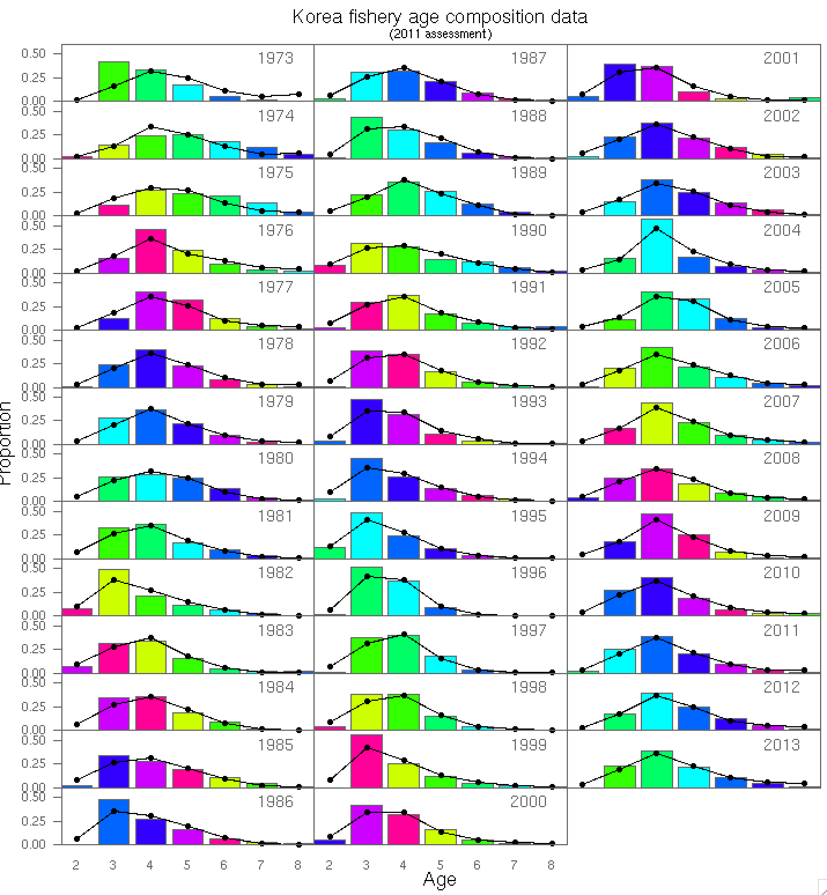
Fit to Fishery age

Slide 38
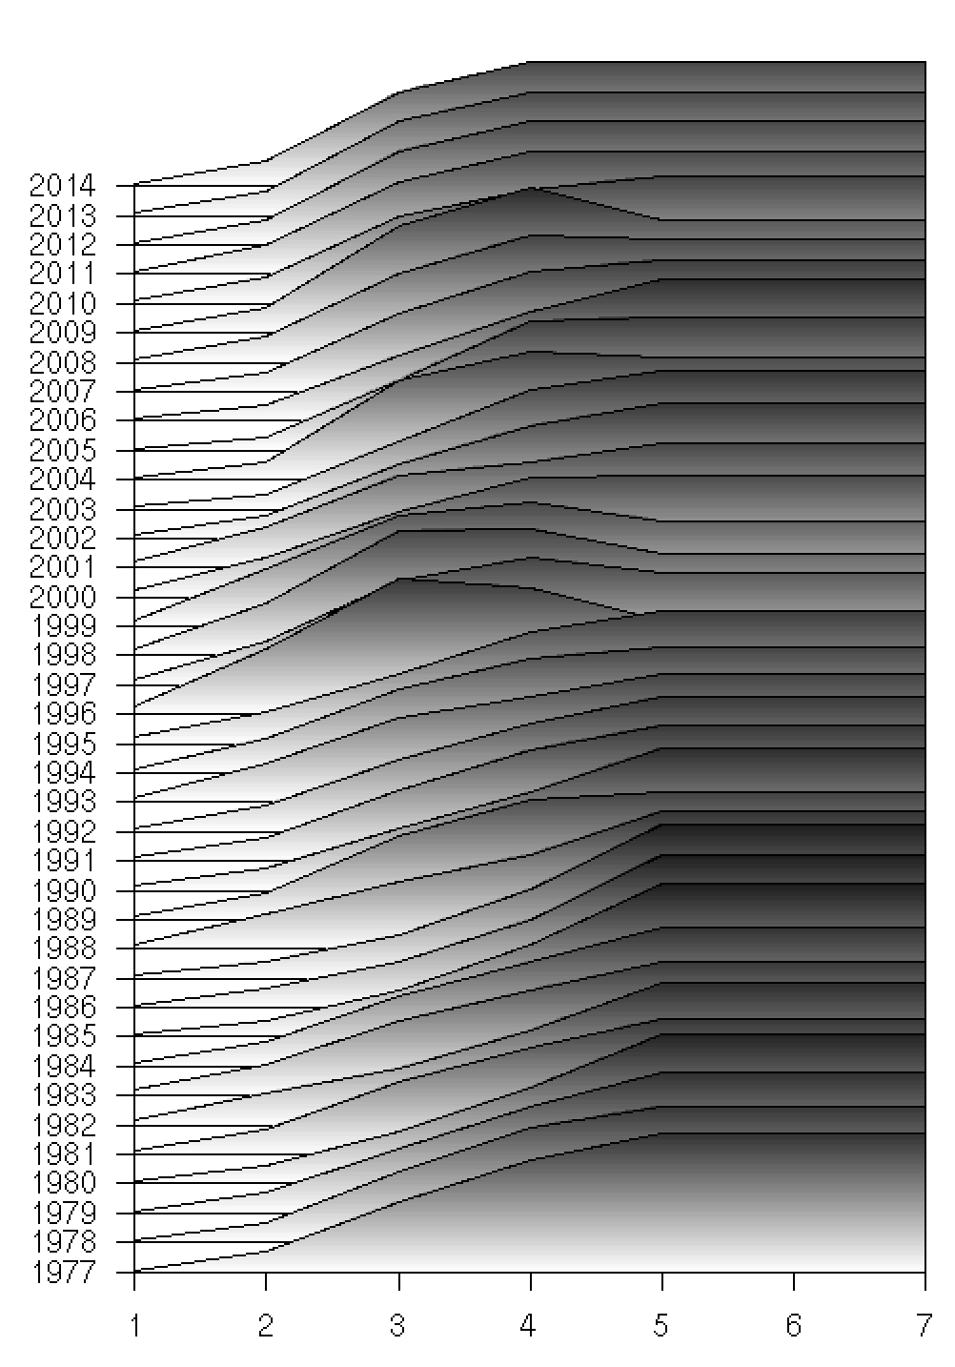
Fit to CPUE and fishery selectivity
Year
Age
Notes:
Age

Slide 42
Model with Pacific and Chinese catch included

Slide 43
Model with East Sea catches only

Slide 44
Model with East Sea catches only, alternative CPUE

Slide 45
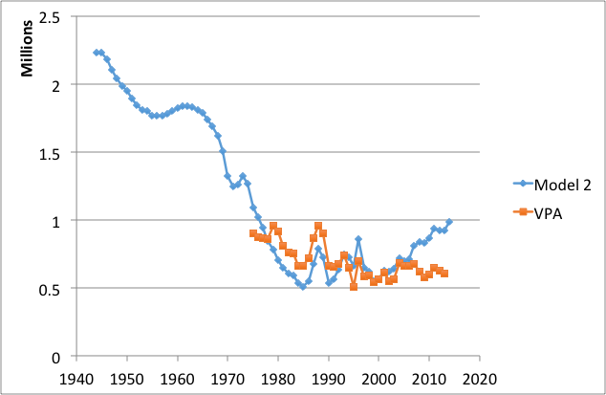
Indicative preliminary results

